Slide 1

Comparison of Text Categorization Accuracy with Different Document Representation
Presented by:
Ishant Sharma 20120001
Karan Khanna 20125016
Monalisa Das 20124102
Vikas Saran 20122044
Oindrila Samanta 20124095

Slide 2
INTRODUCTION
INTRODUCTION
Text categorization is an active research area of Text Mining where the documents are classified with supervised, unsupervised or semi-supervised knowledge.
Text Categorization refers to sorting text documents into one or more pre-defined categories or classes of similar documents.
Main aim- Assign a category to a new document.

Slide 3
APPLICATIONS
APPLICATIONS
Important role in a wide variety of areas - information retrieval, web pages classification, and many more.
Main Applications include:
Spam Filtering
Automatic indexing
Document Organization
Text Filtering
Word Sense Disambiguation
News articles
Personalized newspaper
Hierarchical Web Page Categorization
Recommending
Yahoo-like classification

Slide 4
TEXT CATEGORIZATION MODEL
MODEL
Text Pre-processing
Feature Selection
Text Categorization Method
Feature Representation

Slide 5
TEXT PRE-PROCESSING
MODEL
Stop Words Elimination
A document is considered as a string, and then partitioned into a list of tokens.
Tokenization
Method used to identify the root/stem of a word to reduce the number of words, to save time and memory space.
Stemming
Common words like articles, prepositions, and pro-nouns, etc. that are treated as stop words are removed.

Slide 6
FEATURE REPRESENTATION
MODEL
In the process of representation, there are two key issues need to be considered:
Choice of which features to characterize the semantic of the text, which means the text feature selection.
The other is to choose which model can organize these features, which means the text representation model.

Slide 7
FEATURE REPRESENTATION
Different words for the document have different weights which can calculate the contribution of each word in the document.
The weight calculation methods include Boolean Weighting, Term Frequency Weighting and TF-IDF^{[4]} (Term Frequency-Inverse Document Frequency weighting).
Bag of words (BOW) - Boolean Representation
In this representation, attributes are binary variables indicating the presence or absence of a term in
the document (ignoring the number of occurrences) and are modeled by a discrete distribution.

Slide 8
FEATURE SELECTION
MODEL
Feature-selection helps in the reduction of the dimensionality of the dataset by removing irrelevant features for the classification.
The goal of the reduction is to improve the accuracy of classification.
Another important feature is to reduce over-fitting and to increase generalization.
Best Individual Features can be performed using information gain, chi-square, mutual information.

Slide 9
CATEGORIZATION
MODEL
Supervised, unsupervised and semi supervised are the methods used to classify documents.
Effective methods used for Text Categorization are:
K-NN[3]
Naive Bayes Classifier[4]
TFIDF Classifier[1][4]
Support Vector Machine[2]

Slide 10
Nearest Neighbors Learning Algorithm
CATEGORIZATION
METHODS
Learning is just storing the representations of the training examples in D.
Testing instance x:
–Compute similarity between x and all examples in D.
–Assign x the category of the most similar example in D.
Does not explicitly compute a generalization or category prototypes.
Also called:
–Case-based
–Memory-based
–Lazy learning

Slide 11
K-Nearest Neighbors
K-NEAREST
NEIGHBOUR
Using only the closest example to determine categorization is subject to errors due to:
–A single atypical example.
–Noise (i.e. error) in the category label of a single training example.
More robust alternative is to find the k most-similar examples and return the majority category of these k examples.
Value of k is typically odd to avoid ties, 3 and 5 are most common.

Slide 12
Similarity Metrics
K-NEAREST
NEIGHBOUR
Nearest neighbour method depends on a similarity (or distance) metric.
Simplest for continuous m-dimensional instance space is Euclidian distance.
For text, cosine similarity of TF-IDF weighted vectors is typically most effective.

Slide 13
K-Nearest Neighbour for Text
K-NEAREST
NEIGHBOUR
Training:
For each each training example <x, c(x)> ε D
Compute the corresponding TF-IDF vector, d_{x}, for document x
Test instance y:
Compute TF-IDF vector d for document y
For each <x, c(x)> ε D
Let s_{x} = cosSim(d, d_{x})
Sort examples, x, in D by decreasing value of s_{x}
Let N be the first k examples in D. (get most similar neighbors)
Return the majority class of examples in N

Slide 14
Naïve Bayes Classifier
CATEGORIZATION
METHODS
Naïve Bayes classifiers^{[4][5]} are a family of simple probabilistic classifier.
Assumption: Words are assumed to occur independently of the other words in the document.
Bayes’ rule says that to achieve the highest classification accuracy, ď should be assigned to the class for which Pr(C| ď) is highest.

Slide 15
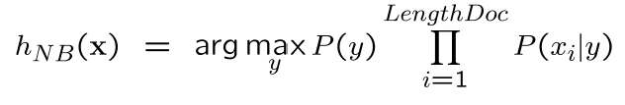
Naïve Bayes Classifier
NAÏVE BAYES CLASSIFIER
Learning phase:
Prior P(Y)
Count how many documents from each topic (prior)
P(X_{i}|Y)
For each topic, count how many times you saw word in documents of this topic(+prior)
Test Phase:
For each document
Use Naïve Bayes Decision Rule^{[4]}:

Slide 16
TF-IDF Classifier
CATEGORIZATION
METHODS
Term frequency TF(wi,d) is the number of times word wi occurs in document d
Document frequency DF(wi) is the number of document in which word wi occurs at least once.
The inverse document frequency IDF(wi) can be calculate from the document frequency
Word weight, d^{(i)} = TF(wi,d) • IDF(wi)

Slide 17
Prototype vector
TF-IDF CLASSIFIER
Learning is achieved by combining document vectors into a prototype vector for each class C∈c.
The resulting set of prototype vectors, one vector for each C∈c ,
represented a learned model.

Slide 18
TF-IDF Classifier
TF-IDF CLASSIFIER
To classify a new document ď, the cosine of the prototype vector of each class which is calculated. The new document is assigned to the class with which its document vector has the highest cosine.
The cosine measures the angle between the vector of document being classified and the prototype vectors of each of the classes.

Slide 19
Support Vector Machine
CATEGORIZATION
METHODS
SVMs^{[2]} maximize the margin around the separating hyperplane.
A.k.a. large margin classifiers
The decision function is fully specified by a subset of training samples, the support vectors.
Solving SVMs is a quadratic programming problem
Seen by many as the most successful current text classification method

Slide 20
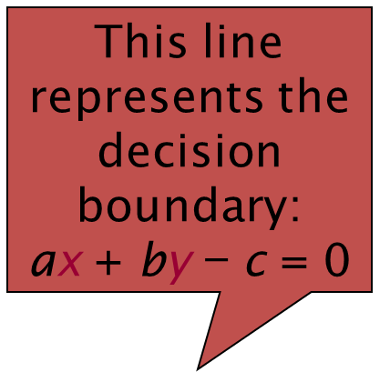
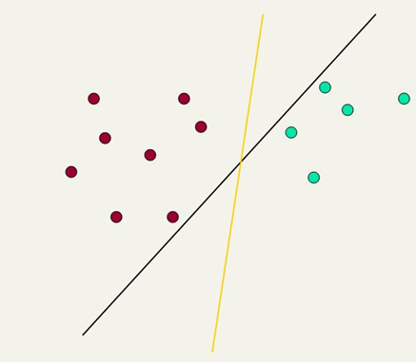

Linear Classifier
SVM CLASSIFIER
Lots of possible solutions for a, b, c.
Some methods find a separating hyperplane, but not the optimal one [according to some criterion of expected goodness]
E.g., perceptron
Support Vector Machine (SVM) finds an optimal* solution.
Maximizes the distance between the hyperplane and the “difficult points” close to decision boundary
One intuition: if there are no points near the decision surface, then there are no very uncertain classification decisions

Slide 21

Geometric Margin
SVM CLASSIFIER
Distance from example to the separator is
Examples closest to the hyperplane are support vectors.
Margin ρ of the separator is the width of separation between support vectors of classes.

Slide 22
Linear SVM Mathematically
SVM CLASSIFIER
Assume that all data is at least distance 1 from the hyperplane, then the following two constraints follow for a training set {(x_{i} ,y_{i})}
For support vectors, the inequality becomes an equality
Then, since each example’s distance from the hyperplane is
The margin is:
w^{T}x_{i} + b ≥ 1 if y_{i} = 1
w^{T}x_{i} + b ≤ −1 if y_{i} = −1

Slide 23
Framework Structure
Details of Solution
Details of Solution

Slide 24
Solution Approach
Details of Solution
In each of the classification techniques, we used the following approach:
The train-test split ratio has been varied from 99% to 1% for the given data.
At each train-test split, precision is calculated for Bag of Words, TF, and TFIDF representation of data and is plotted.
We split the data using Stratified K-Fold algorithm with k = 5.
We have performed the experiments in 2 parts :
Using 6 of the 20 newsgroup(‘electronics`, `crypt`, `space`, `hockey`, `motorcycles` and `forsale`) categories.
Using the entire 20 newsgroup dataset.

Slide 25
Classification Accuracy
Results
Method | Accuracy
BOW - NB - 20% test | 0.97
TF - NB - 20% test | 0.94
TFIDF - NB - 20% test | 0.95
TFIDF - SVM - 20% test | 0.97
TFIDF - SVM - 90% test | 0.92
TFIDF - SVM - KFOLD - 20 classes | 0.893 (+/- 0.003 std)
TFIDF - 5-NN - Distance Weights - 20% test | 0.90
TFIDF - 5-NN - Uniform Weights - 20% test | 0.93
TFIDF - 5-NN - Distance Weights - KFOLD | 0.909 (+/- 0.004 std)
TFIDF - 5-NN - Distance Weights - KFOLD - 20 classes | 0.756 (+/- 0.003 std)

Slide 26
Graph Plots
Results
(y – Accuracy, x – Split ratio) (y – Accuracy, x – Split ratio)
Fig. 2: Naïve Bayes Fig. 3: KNN

Slide 27
Graph Plots
Results
(y – Accuracy, x – Split ratio) (y – Accuracy, x –Kth Nearest Neighbour)
Fig. 4: SVM Fig. 5: KNN(Uniform and Weighted)

Slide 28
Conclusion
Conclusion
The tests show that text classification can be effectively done by simple tools like TFIDF [8] and SVM. We have found that TFIDF [8] with SVM have the best performance. TFIDF with SVM perform well both for 2-class problem and 20-class problem.

Slide 29
Related Work
RELATED WORK
Mingyong Liu and Jiangang Yang^{[3]} proposed a new weighting method named TF-IDF-CF based on TF-IDF which is a widely used weighting method in text categorization.
TF-IDF-CF = Log( tf(i,j) + 1 ) * log( N+1/ n(j) ) * ( n( c,(i,j) )/ Nci )
Where :
n( c,(i,j)) - represents the number of documents where term j appears within the same class c document i belongs to
Nci - represents the number of documents within the same class c document i belongs to
Accuracy of various methods is obtained on the two datasets (Reuters and 20news) as:
Method Naive Bayes Bayes Network KNN SVM
 | Reuters | 20news | Reuters | 20news | Reuters | 20news | Reuters | 20news
TF-IDF | 61.6% | 61.9% | 76.9% | 65.3% | 72.8% | 55.3% | 84.7% | 69.1%
TF-IDF-CF | 88.6% | 77.1% | 91.4% | 77.7% | 81.4% | 64.9% | 92.8% | 78.7%

Slide 30
REFERENCES
REFERENCES
[1] Mingyong Liu and Jiangang Yang, 2012, “An improvement of TFIDF weighting in text categorization”.
[2] Ron Bekkerman , James Allan, 2003, “Using Bigrams in Text Categorization”.
[3] Bruno Trstenjak , Sasa Mikac and Dzenana Donko, 2013 , “KNN with TF-IDF Based Framework for Text Categorization”.
[4] Thorsten Joachims, Carnegie Mellon University, “A Probabilistic Analysis of the Rocchio Algorithm with TFIDF for Text Categorization”.
[5] Wongkot Sriurai, 2011, “Improving Text Categorization by Using a Topic Model” published in
an International Journal Advanced Computing, Vol.2, Issue 6, pp 21-27.
[6] Juan Ramos, “Using TF-IDF to Determine Word Relevance in Document Queries”.
[7] Ami Singhal. Modern Information Retrieval: A Brief Overview. IEEE, 2001: 2-4.
[8] Matthew A. Russell Mining the Social Web. O’Reilly Media; Second Edition, October 22,
2013.
[9] 20 Newsgroup Dataset. http://qwone.com/~jason/20Newsgroups/

Slide 31
THANK YOU

